Slide 1

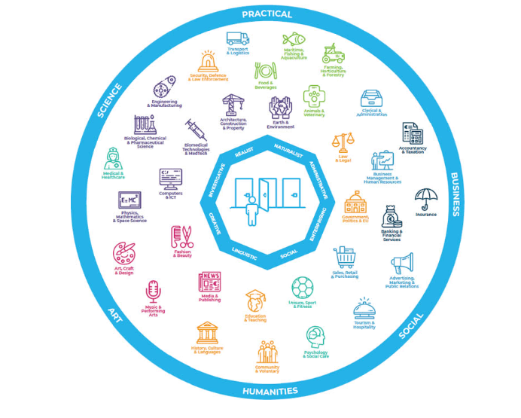

Slide 2
Understand the sectors Irish world of work and education.
Be introduced to 8 different types of Career Interests.
Complete an exercise to help you identify your top 3 Career Interests.
Be introduced to and complete the Career Interests Profiler app.
Explore how your top 3 Career Interest types are matched to a range of jobs, apprenticeships and courses at different levels.
Reflect on your learning from doing this app and discussing your results.

Slide 3

What are Career Interests?
Interests are things you enjoy. Often, we are interested in things we are good at e.g., football, art, or cooking. Sometimes you may be interested in something you haven’t tried yet e.g., skydiving, photography or fixing things.
Sometimes you may be interested in something, but you may not have the aptitude, skill, talent or personality e.g., a singer in a band. However, rather than singing in a band, you might follow this area of interest and become involved in some other way e.g., tour manager, record producer, or a musician.
Your future career is likely to be motivated by the interests they have, and people often go on to study and then work in areas that support activities that they are drawn to.
There are 8 "Career Interest" types that can be helpful for you to understand. These can then be used to help to match you to courses, apprenticeships and jobs that suit you best. These may change in the future as you learn more, and develop your experience and career. So, it is always worth exploring your interests again over time!

Slide 4

Which way for you?
Exploring Career Interests is one of the most useful ways of finding a career direction.
In the exercises that follow, we will explore ways of revealing your Career Interests and show you how knowing about your interests can be used to identify career paths.

Slide 5
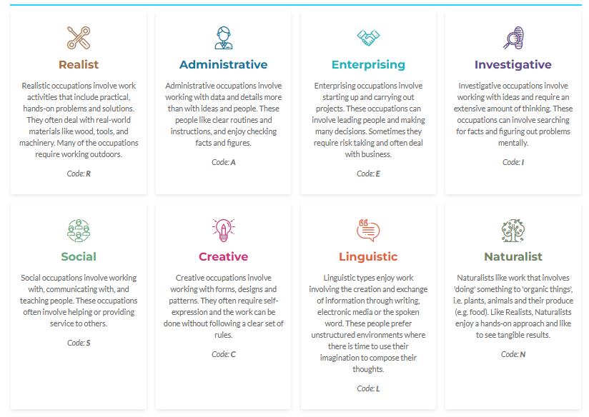
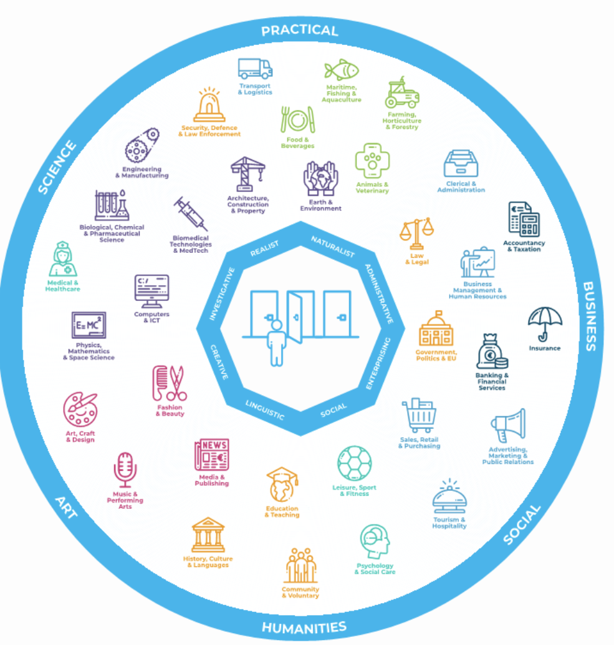
This diagram illustrates the relationship clearly - e.g., a Social person might be well suited to careers in education, sport, sales or tourism.

Slide 6

Exercise: Career Interests
You are on a work experience placement, and your mentor has been watching the tasks you have been doing, and noticing the ones you are showing the greatest interest in.
They now want to see what other areas of work and training might suit you best and have invited you to take the MyFuture+ Career Interest Profiler app.
Before you take the on-line quiz you can look at the meaning of the 8 different interest types and guess what you think your strongest are in the order of your 1st, 2nd and 3rd ones.

Slide 7
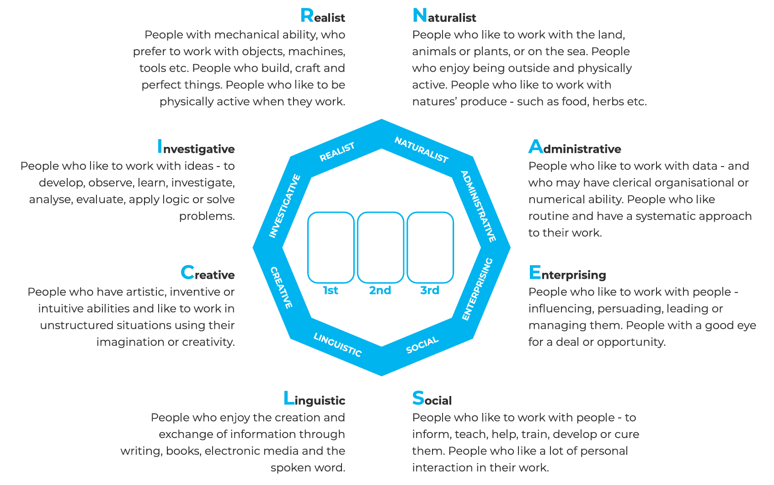
Guess Your Top 3 Career Interests?
Worksheet: click here

Slide 8
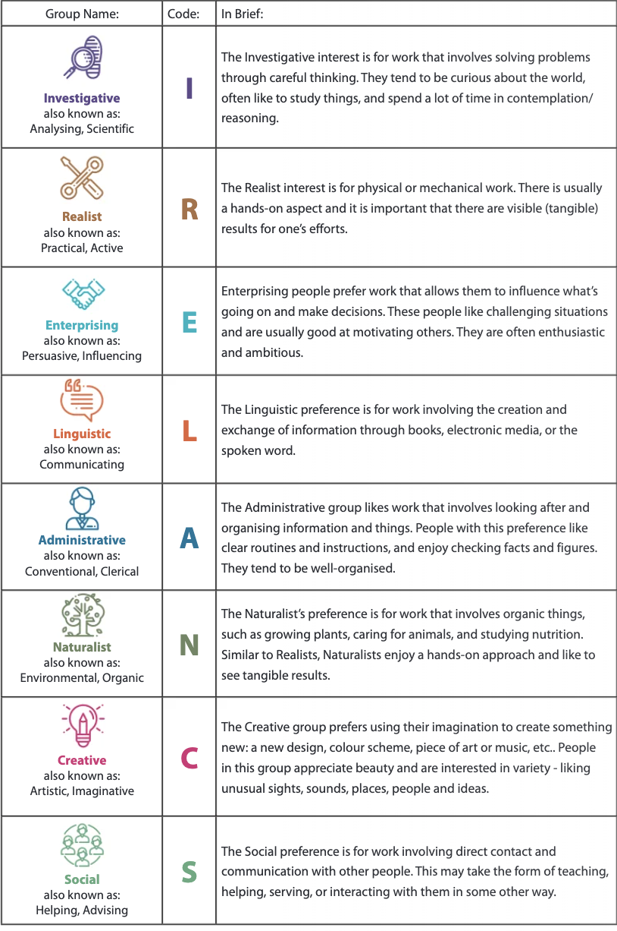
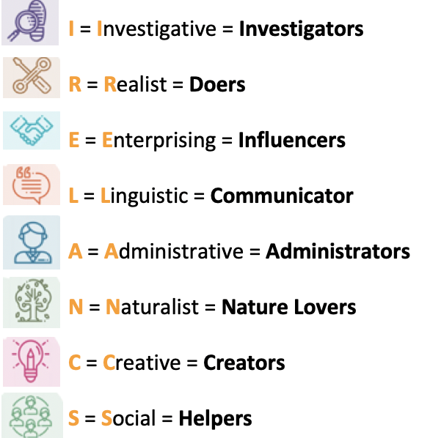
Interest Groups
What they mean and how they relate to jobs and courses that may suit you!

Slide 9
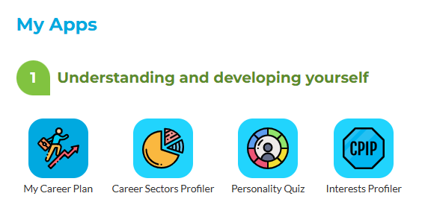

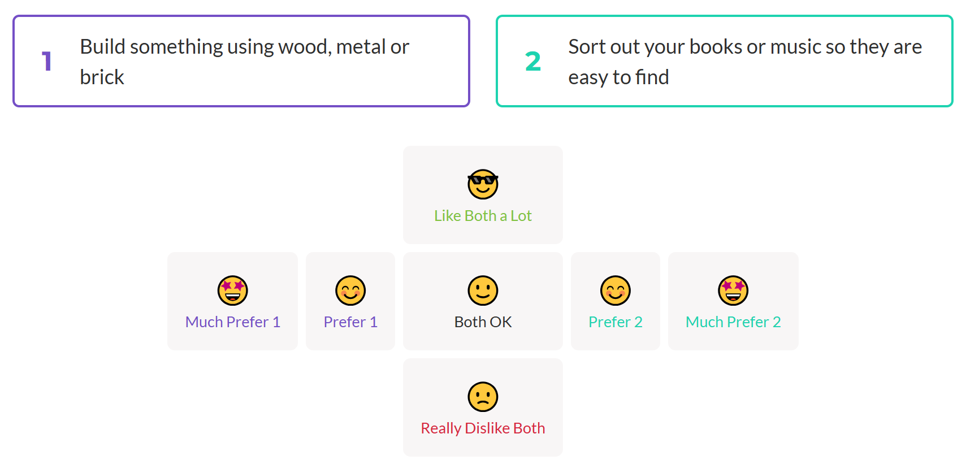
Step 1: Click on the Interests Profiler app
Step 2: Choose young adult or adult version
Step 3: Read both statements and choose an emoji that suits you best

Slide 10
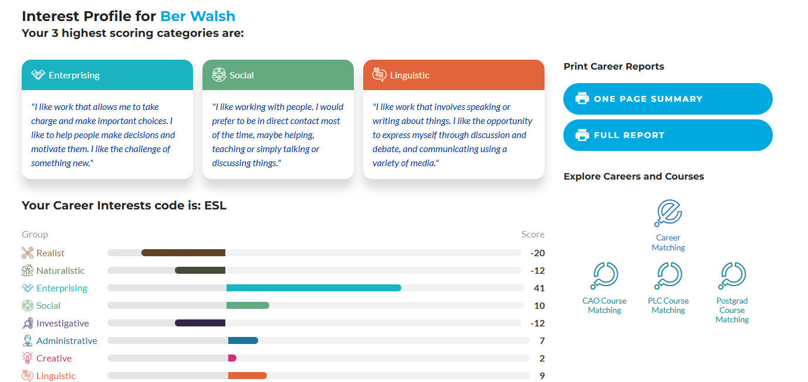
At the end of the on-line questionnaire you will find out your Top 3
You can then match your top 3 to Jobs… (Career Matching)
or Courses…
(CAO, PLC or Postgraduate)

Slide 11


If your first choice or career interest type was “C’ for Creative this means that you may be suited to careers such as art, design or music. If it was ’N’ for Naturalist this means you may be interested in careers involving nature, plants, animals and the environment.

Slide 12
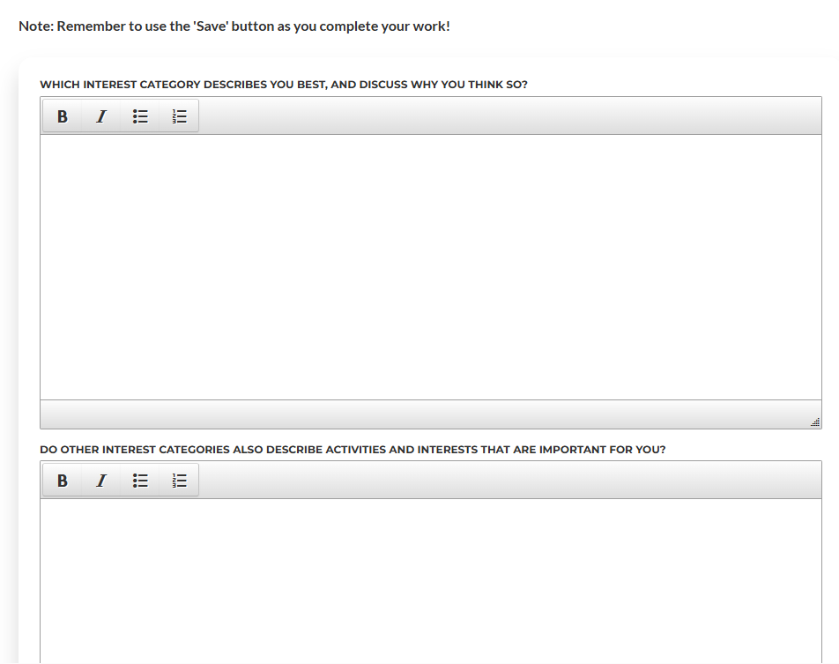

Exercise: Career Interest Reflection
It is important to include your thoughts and learning on your results and matched job and course options.

Slide 13
Understand how 8 different career interest types link to the many career sectors in the world of work and education.
Name and understand your top 3 career interests.
Match these career interests to jobs, apprenticeships and courses that suit you best at this stage of your life.
Complete other MyFuture+ apps to support you to understand and develop yourself further, and to plan your next step!

