Slide 1

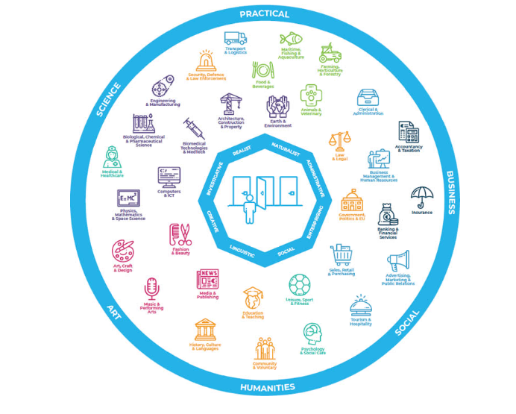

Slide 2
Explore the 33 sectors Irish world of work and education.
Learn how career interest types can be linked to certain career sectors.
Discover how each sector can be broken down into sub-sectors or career areas.
Complete the Career Sectors Profiler app.
Understand based on completing the app what your top matched sectors.
Explore each of your top matched sectors and understand their opportunities e.g., types of occupations, courses, any apprenticeship and live jobs.

Slide 3
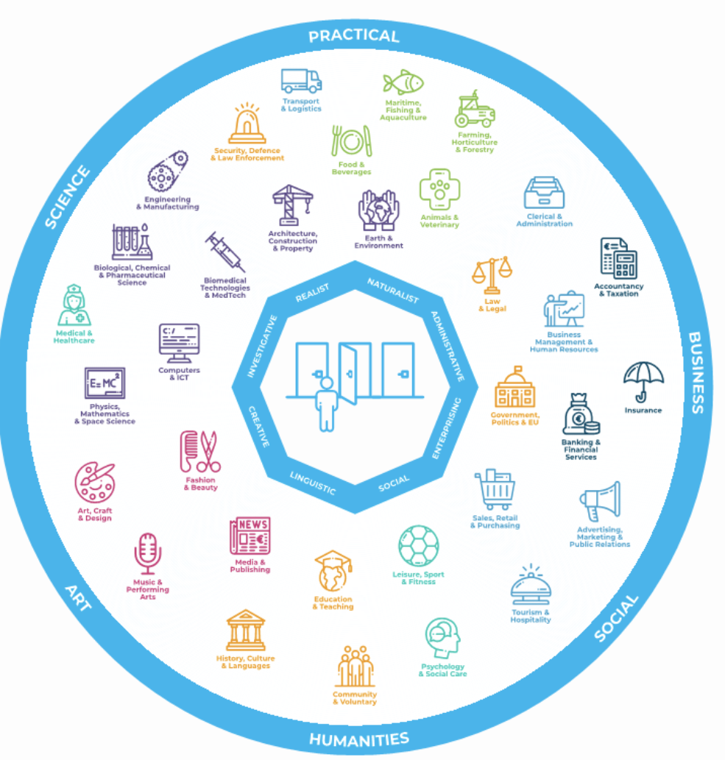
What are Career Sectors?
The World of Work can be divided into several groupings or Sectors.
In MyFuture+ there are 33 different Career Sectors which are listed under 7 main categories that are colour coded in the World of Work diagram:
Agriculture, Animals & Food; STEM, Environment & Construction; Health, Wellbeing & Sport; Creative Arts, Fashion & Media; Government, Law & Education; Accountancy, Finance & Insurance; Business, Sales & Tourism.
Exploring Career Sectors is an excellent starting point when thinking about choosing a career direction.
You can start with a broad overview of the world of work and then refine your choices by selecting the sectors that interest you most.

Slide 4
The Relationship between Career Sectors and Interest Types
This diagram illustrates the relationship clearly - e.g., a Social person might be suited to careers in Education, Sport, Sales or Tourism
The 8 Career Interest Types are:
Realist
Naturalist
Administrative
Enterprising
Social
Linguistic
Investigative
Creative

Slide 5

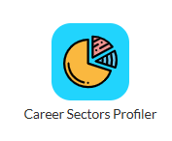
Each of the 33 Sectors can be broken down into more specific career areas or Sub-Sectors to help us understand the many options within each of the sectors.
The Career Sectors Profiler app is an exercise that will help you understand more about what career areas suit you best.

Slide 6
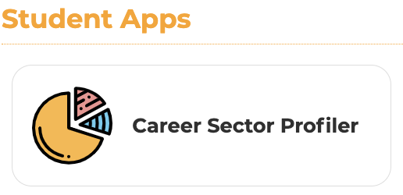

Exercise: Create your Career Sectors Profile
Login to your MyFuture+ account, select
Section 1: Understanding and Developing Myself
and answer the 33 questions in the Career Sectors Profiler app.

Slide 7
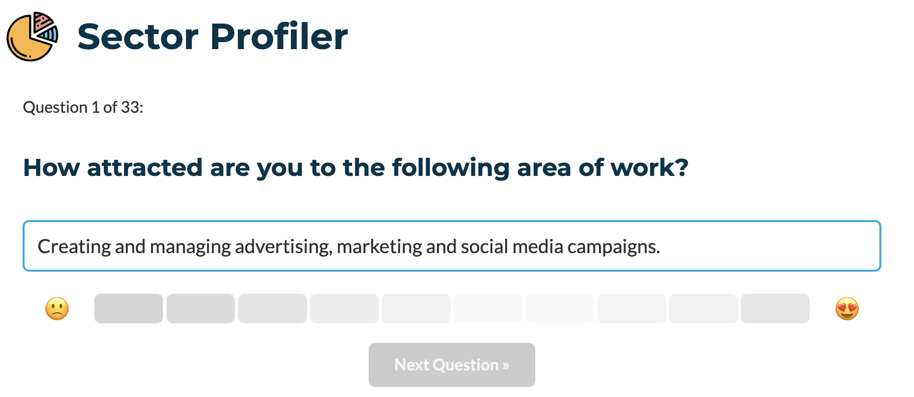
Exercise: Create your Career Sectors Profile

Slide 8
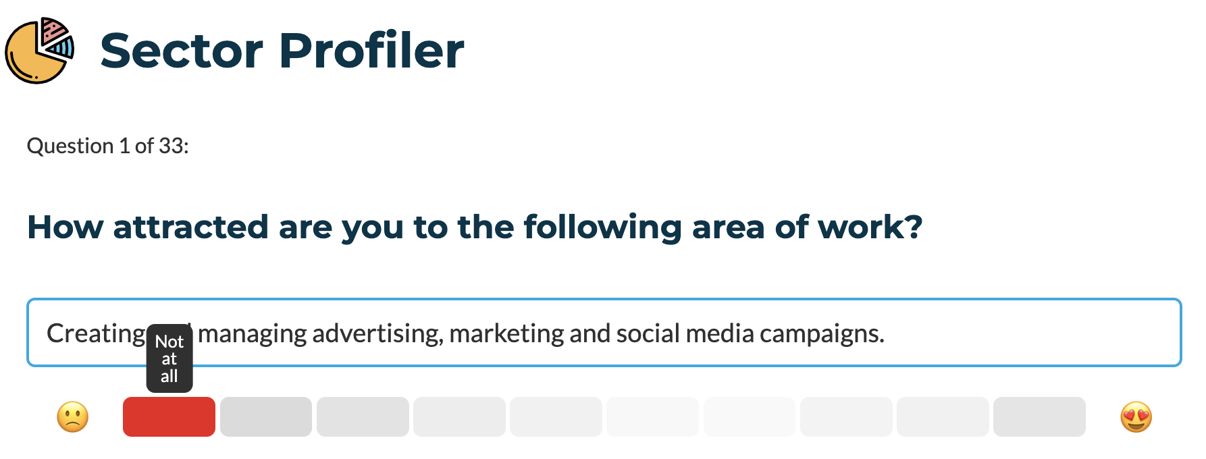
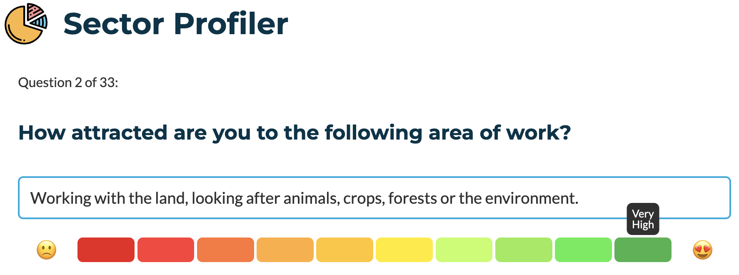
Exercise: Create your Career Sectors Profile
Answer on a Scale “Not at All” to “Very High”

Slide 9
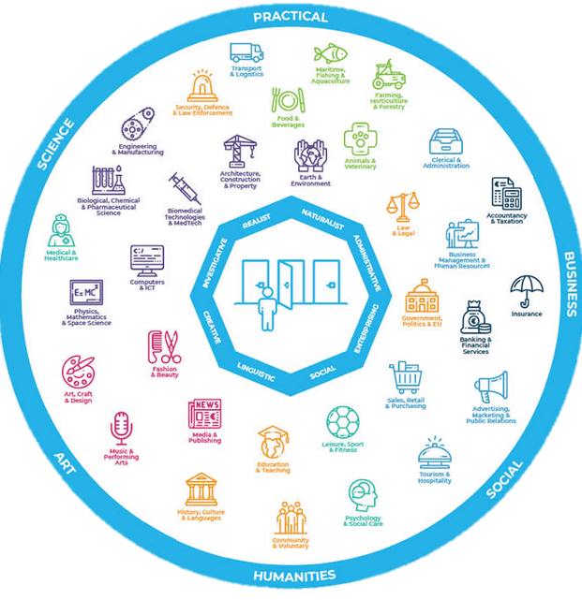
Exercise: Create your Career Sectors Profile
Take a note of which of these seven Career Sector categories that you show the strongest preference for:
Agriculture, Animals & Food
STEM, Environment & Construction
Health, Wellbeing & Sport
Arts, Fashion & Media
Government, Law & Education
Accountancy, Finance & Insurance
Business, Sales & Tourism

Slide 10
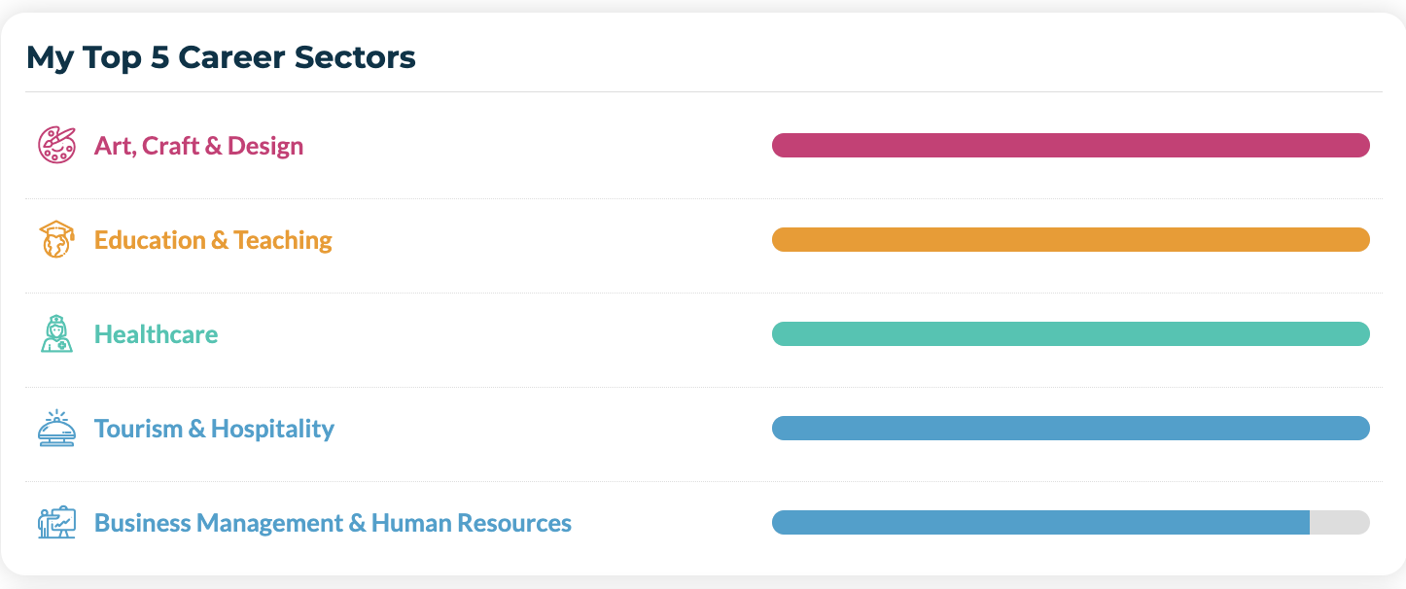
Exercise: Create your Career Sectors Profile
Select any of your Top 5 Career Sectors to explore in more detail and discover the opportunities they offer.

Slide 11
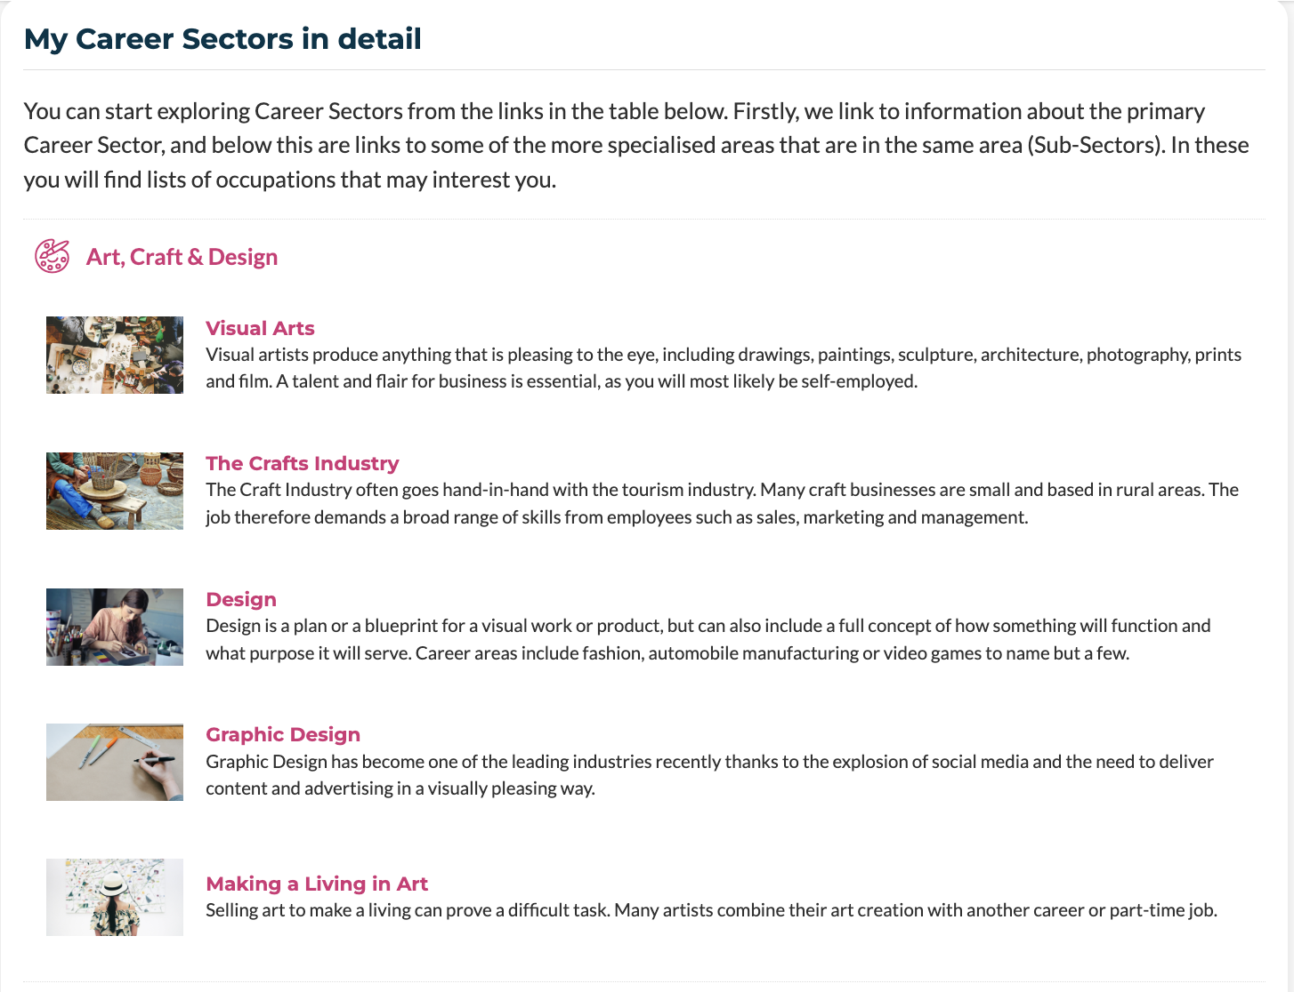
Exercise: Create your Career Sectors Profile
For example, you may choose to investigate Art, Crafts & Design in more detail…
Or you may choose to investigate one of the specialised sub-sectors e.g. Design.

Slide 12
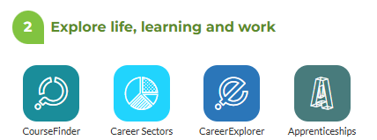
Exploring all 33 sectors
You can view all sector information in Section 2 of your MyFuture+ Career File:

Slide 13
In todays lesson you will have….
Developed an understanding of the 33 main Career Sectors in the Irish Economy
Completed the Career Sectors Profiler App
Gained insights into a Career Sector that is of most interest to you and know about the sub-sectors within it

