Slide 1

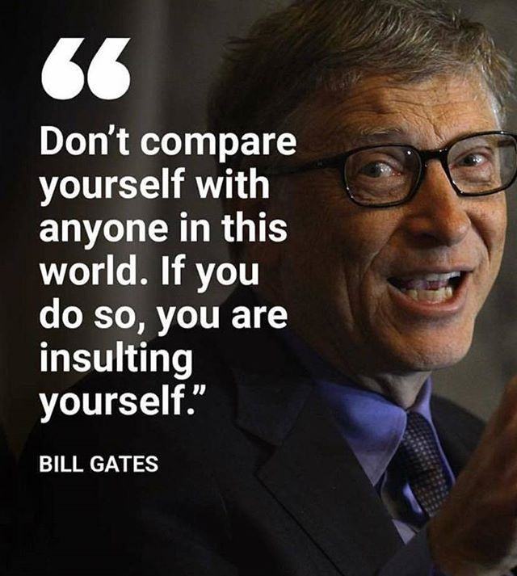

Personality – A Definition
“the combination of characteristics or qualities that form an individual’s unique character”

Slide 3

Personality – What is it?
”Personality is to a person what perfume is to a flower.”
- Charles M. Schwab
Everybody has a personality - it’s what makes us unique. Our personality is one of the building blocks of who we are – it influences our values, interests, how we learn, what we notice and how well we get on with others.
Our personality seems to be partly formed when we are born, and develops and grows according to our experiences through our life.
There are lots of theories about personality, but no one theory seems to account for everything.
In MyFuture+ you will explore one theory based on the “Kiersey temperament sorter” and understand 4 types in this lesson. This will help you to understand your top one and some jobs/careers that might be a good fit for you.

Slide 4
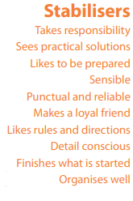
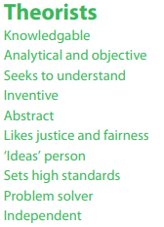
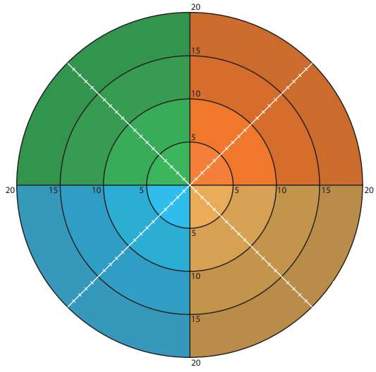
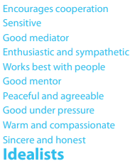
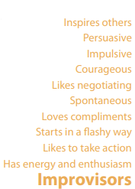
Personality – The 4 Types

Slide 5

Idealists are concerned with personal growth and want their life to be meaningful and significant.
They like to be with people, sharing with them, encouraging them and helping them to grow and develop.
This is the most philosophical of the four personality types.
They place a high value on being true and honest with themselves and others and are always ready to help out when a friend needs them.

Slide 6
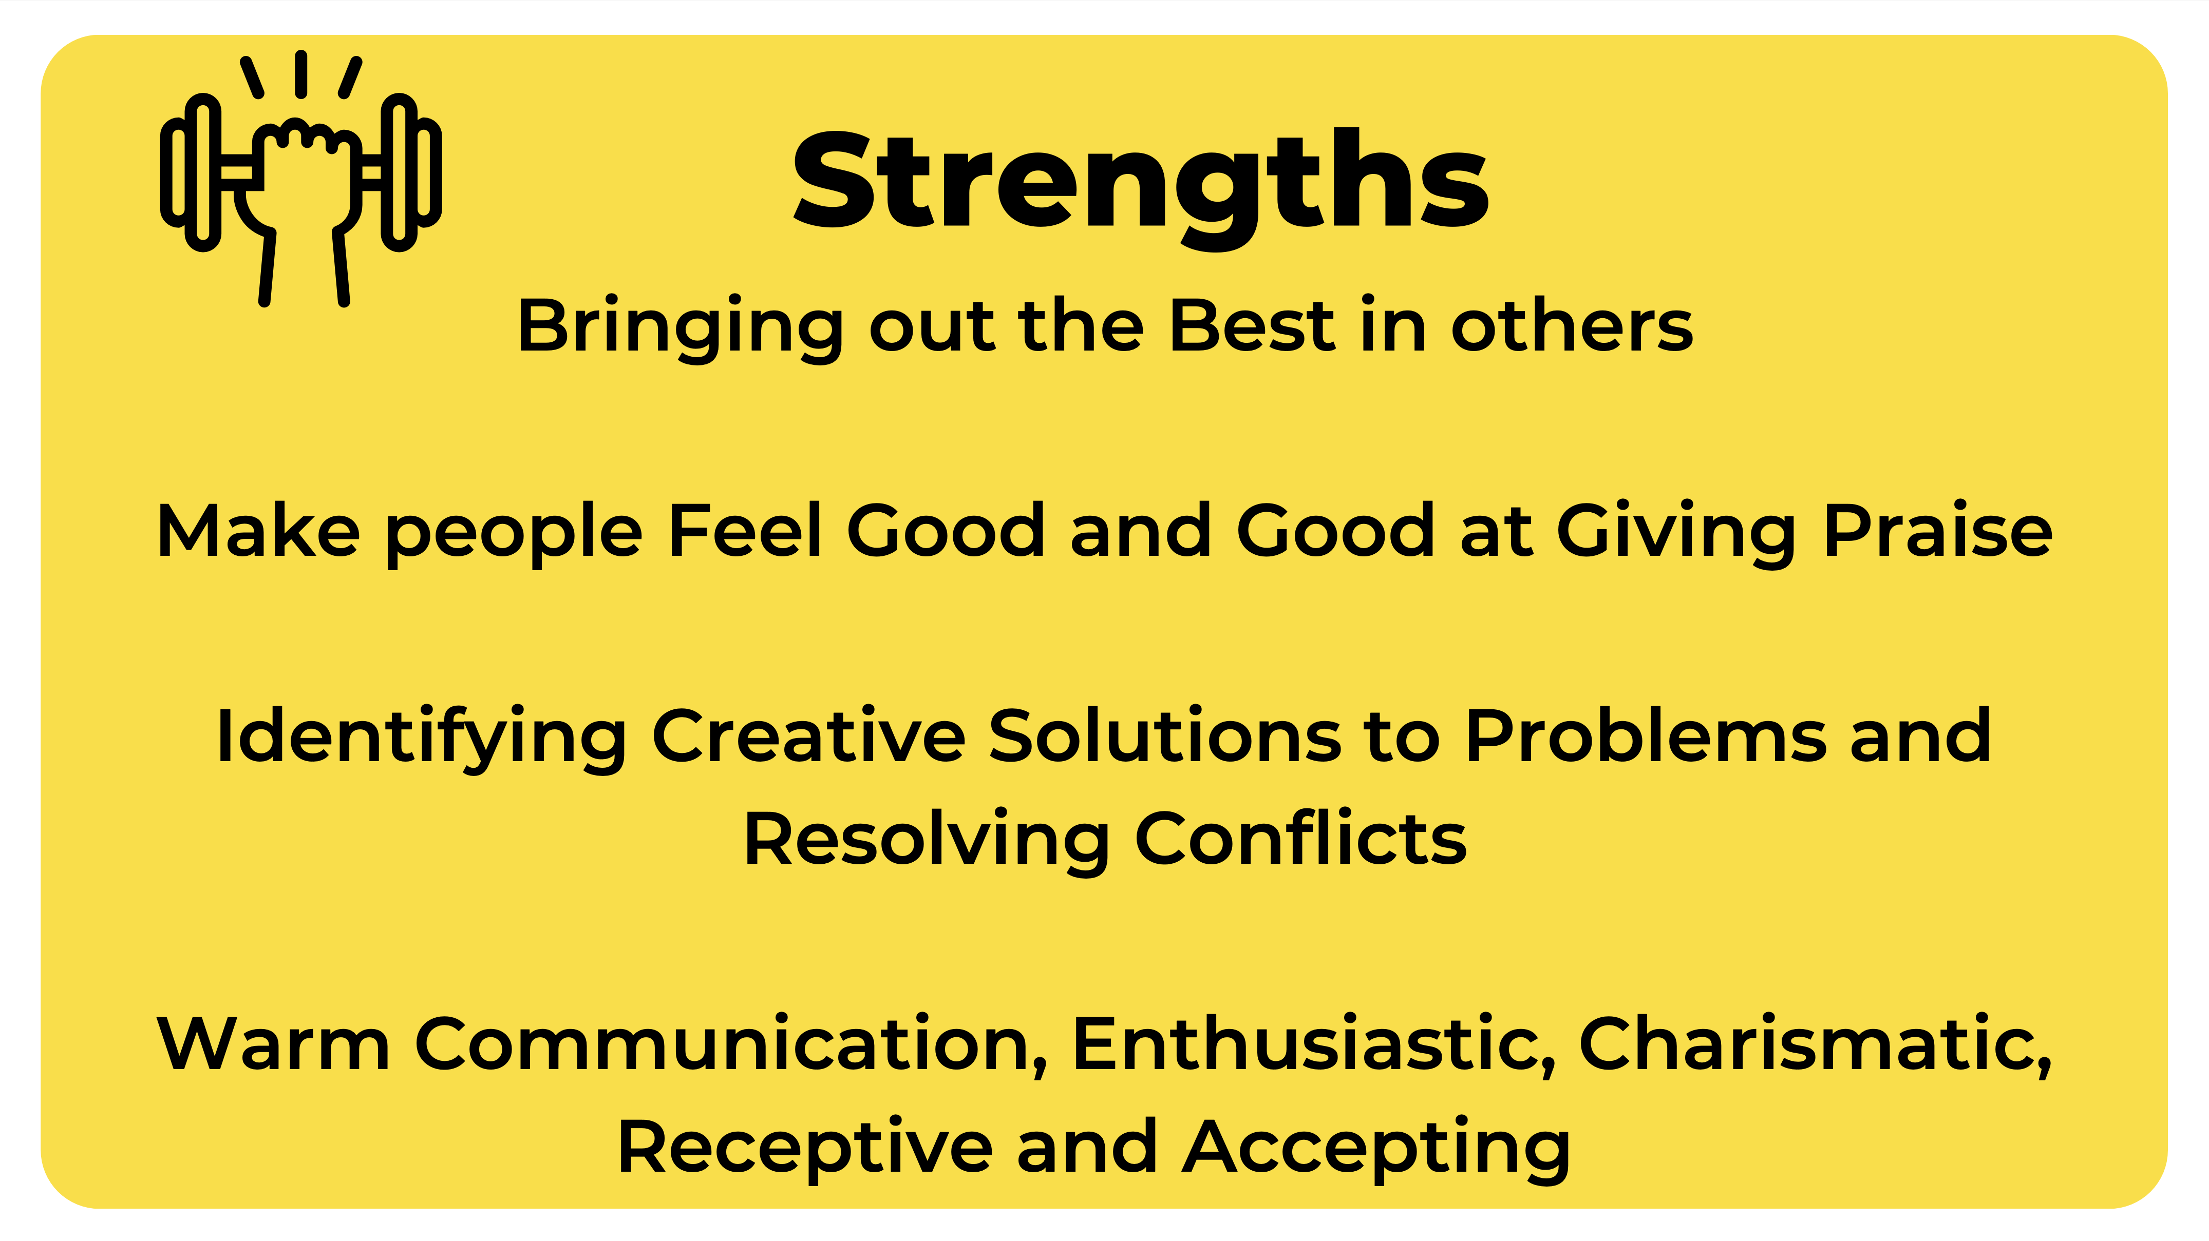
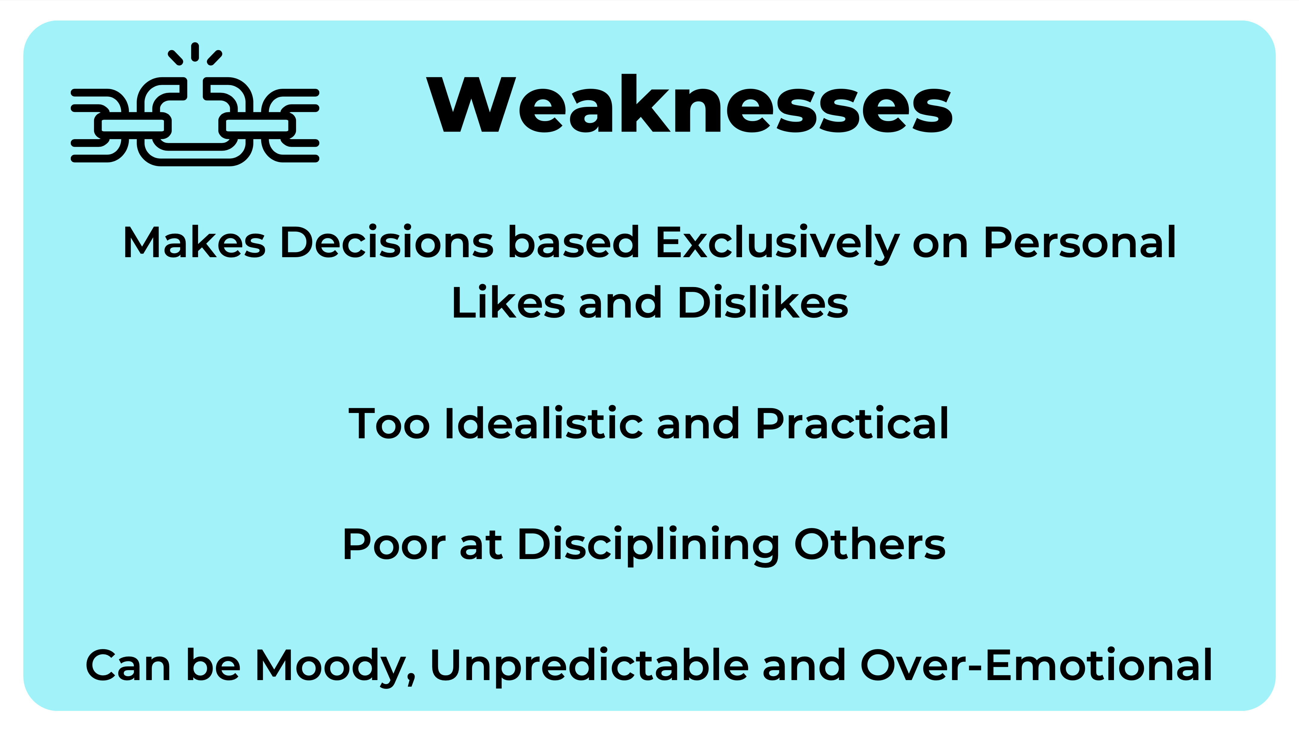
Strengths & Weaknesses of Idealists

Slide 7
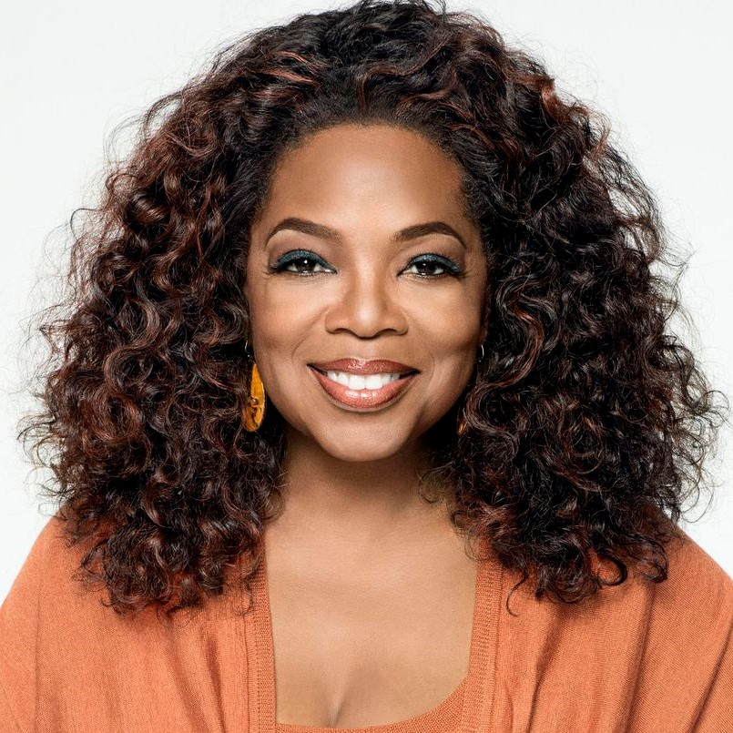
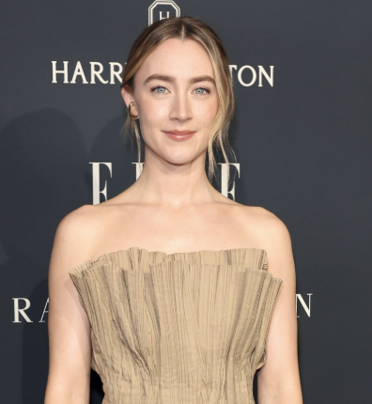
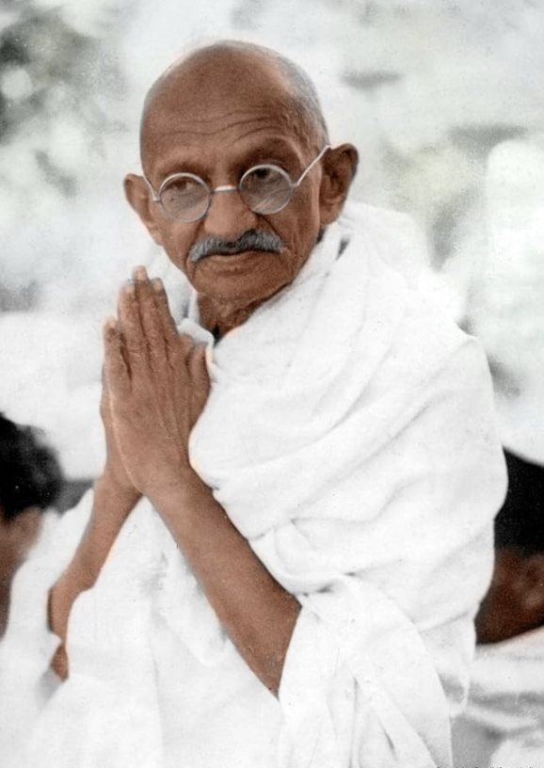
Career interests of Idealists:
Famous Idealists
Oprah Winfrey, Saoirse Ronan and Mahatma Gandhi
Idealists can be happy in a very wide range of career areas.
Idealists tend to study the Humanities and Caring Professions. They seek careers facilitating the personal growth of others, whether through education, counselling, or other pursuits that promote the happiness and fulfilment of individuals and society.
Sectors include:
Human Resources
Teaching
Counselling
Consulting
The Arts

Slide 8

Stabilisers value Law and Order.
They like when there are Clear Rules and Guidelines and are driven by a strong motivation to Serve our Society’s Needs.
They respect Authority and the Chain of Command.
They are bound by a Sense of Duty to do the Right Thing, which tends to make them Reliable, Dependable and Responsible.

Slide 9
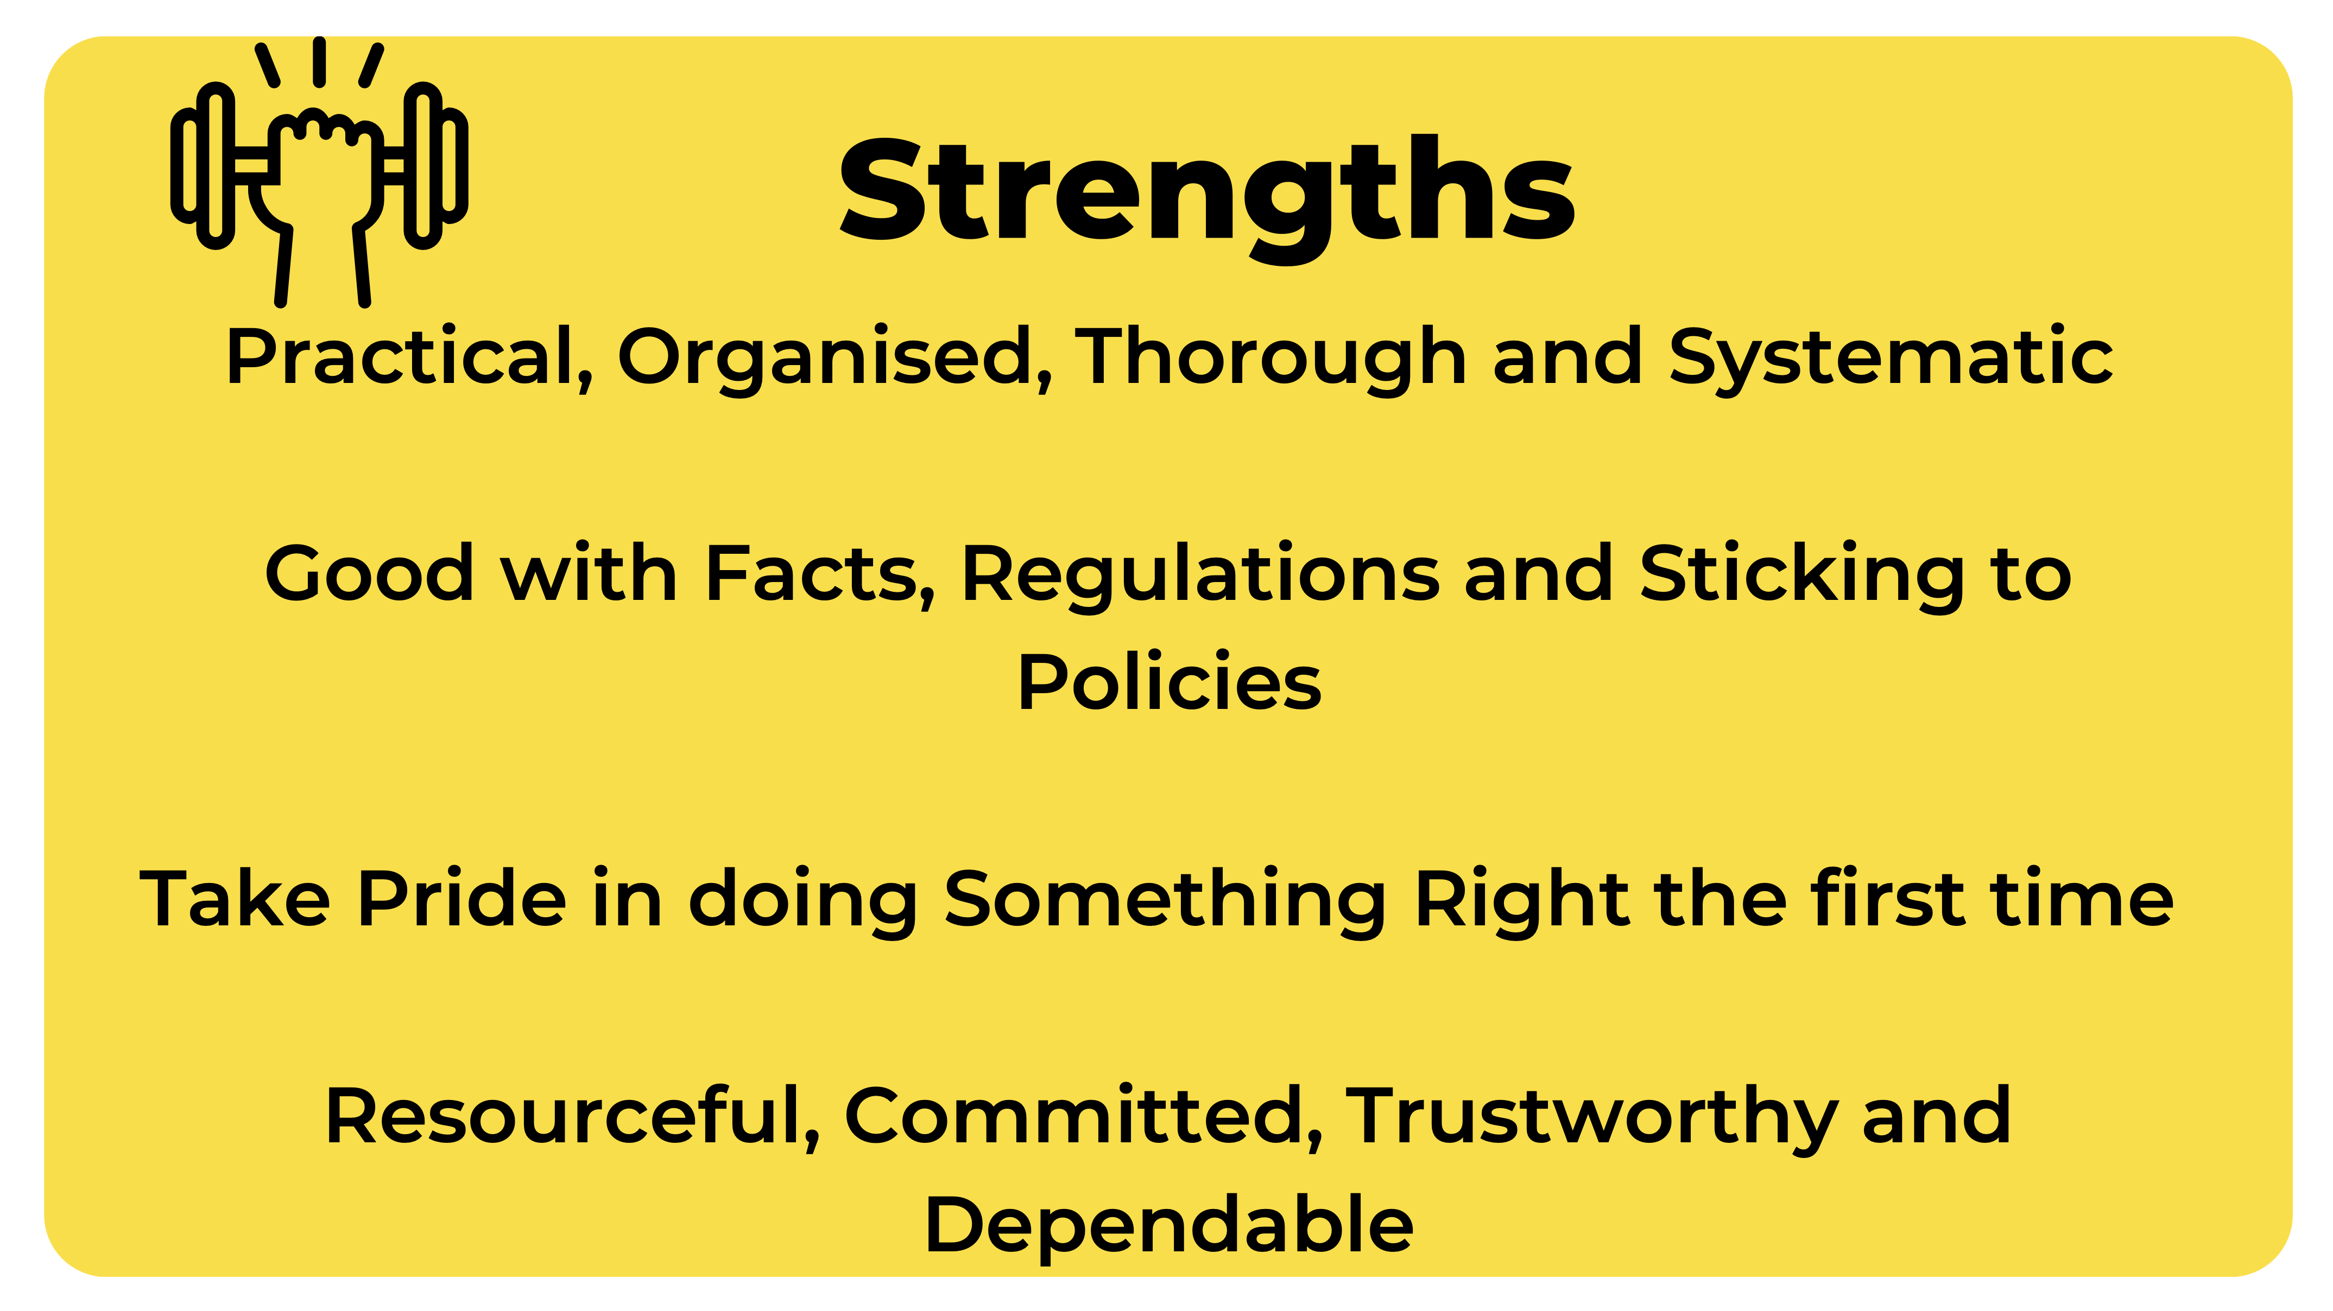
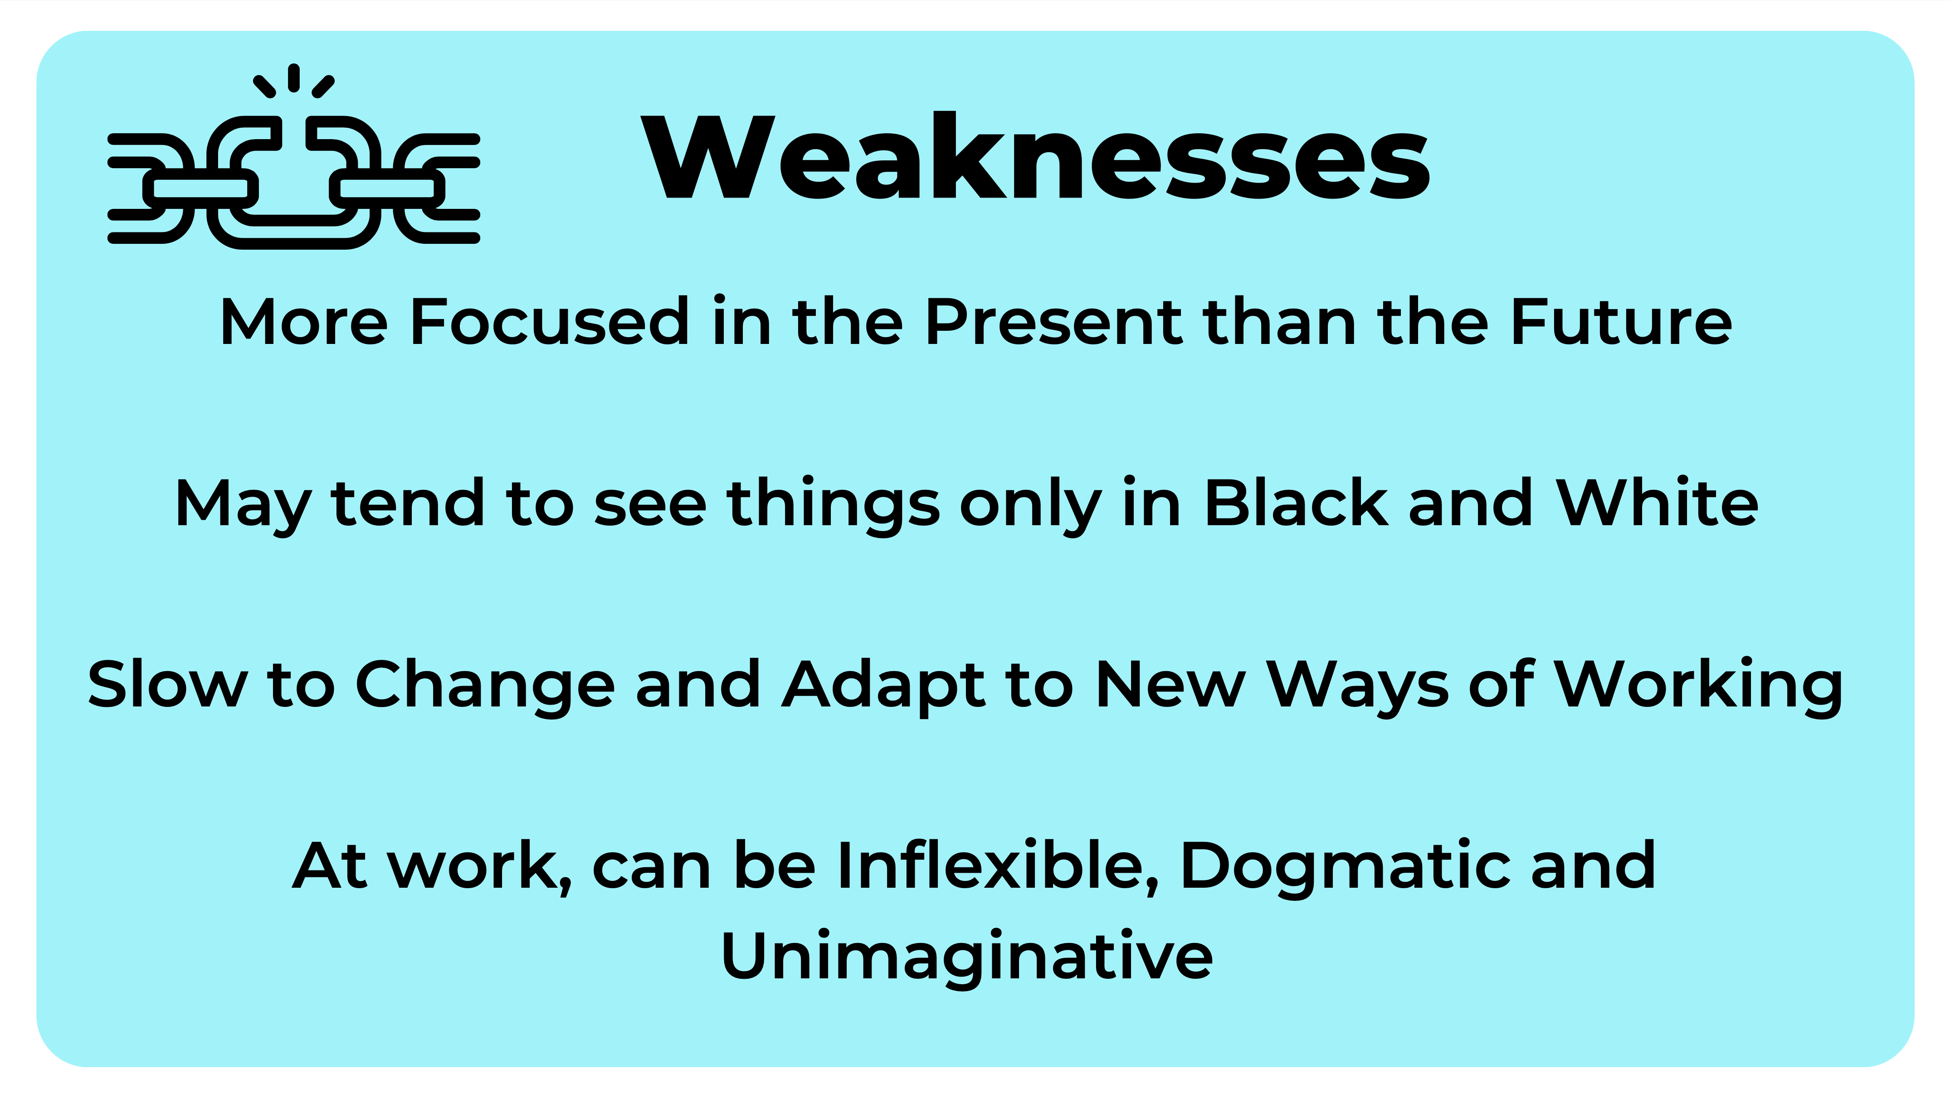
Strengths & Weaknesses of Stabilisers

Slide 10
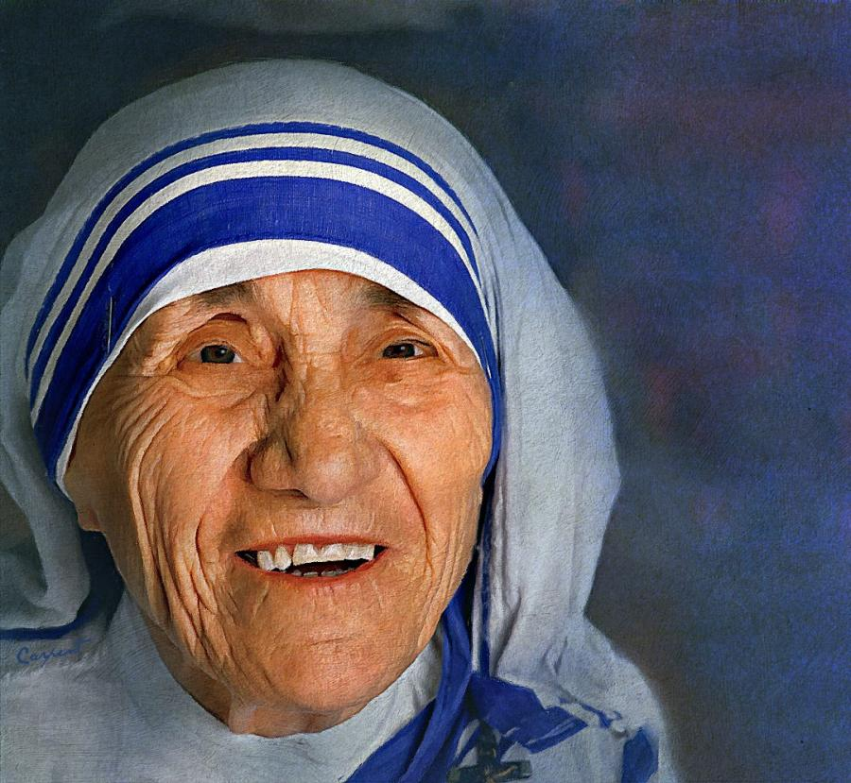
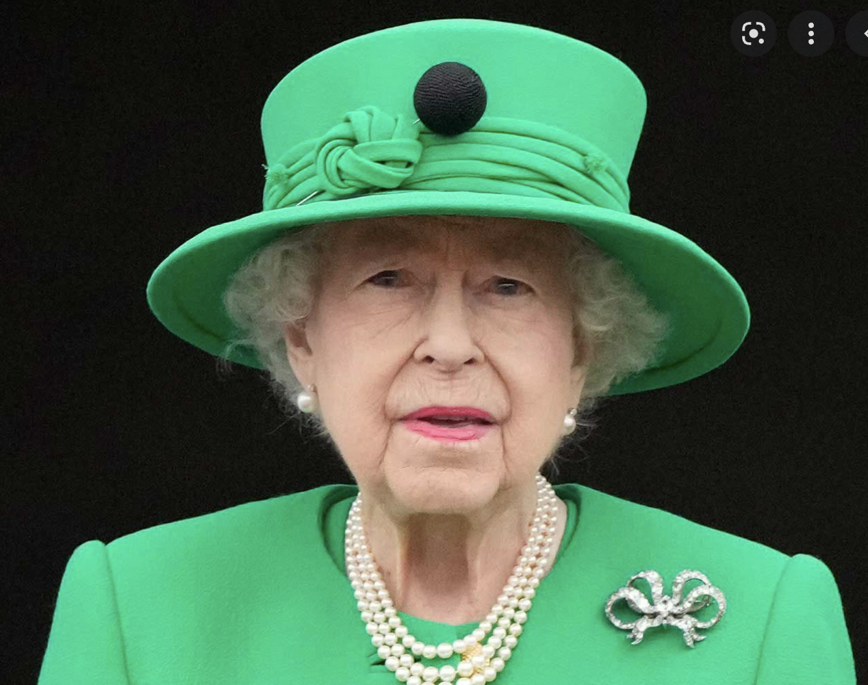
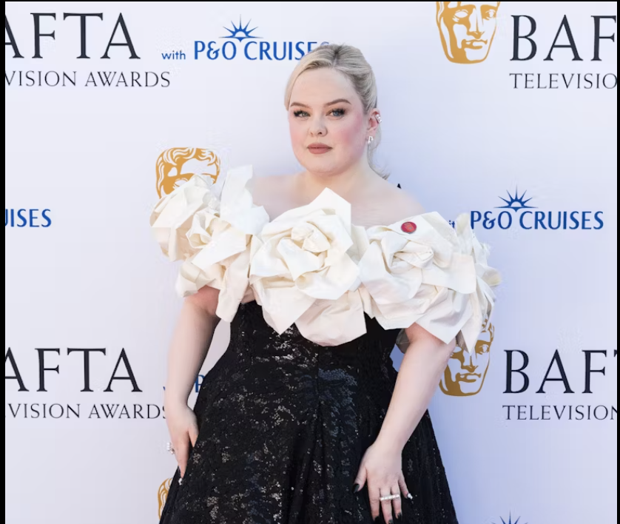
Career interests of Stabilisers
Famous Stabilisers
Mother Teresa, Queen Elizabeth II and Nicola Coughlan
In their education and careers, the primary interest of Stabilisers is likely to be within Business and Commerce, with an eye toward Practical Applications in Management.
Stabilisers frequently make good Managers. Other sectors include:
Quality Assurance
Legal Professions
Accounting
Risk Management
Pharmacy

Slide 11

Improvisers seek Freedom, Independence and Adventure.
They have a Zest for Life, want to Test their Limits and they take pride in developing Skills across a variety of fields.
Improvisors are excellent negotiators and possess the ability to understand what needs to be done.
They value freedom and spontaneity and seldom choose careers that impose too much structure or rules.

Slide 12
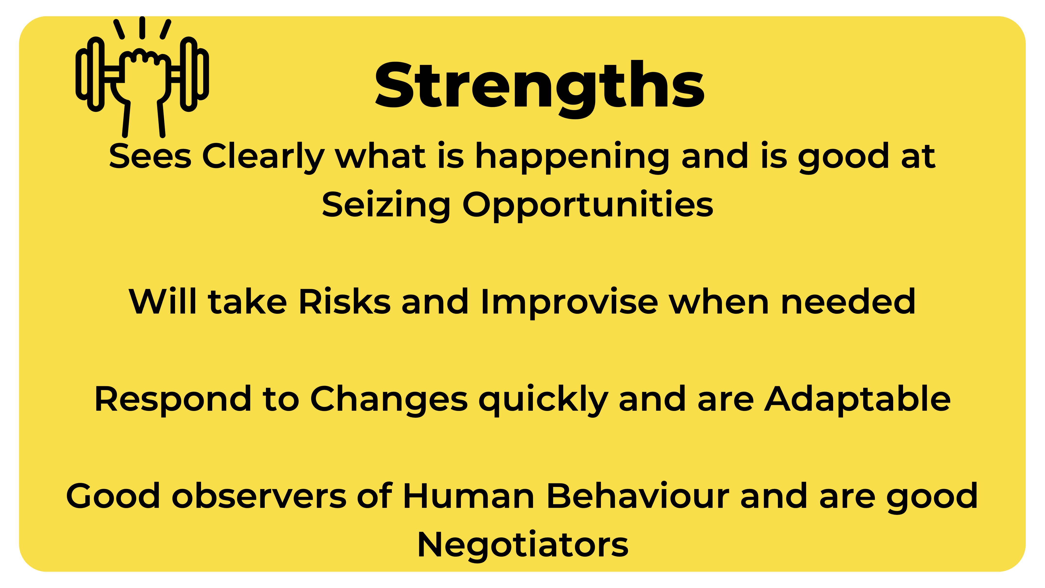
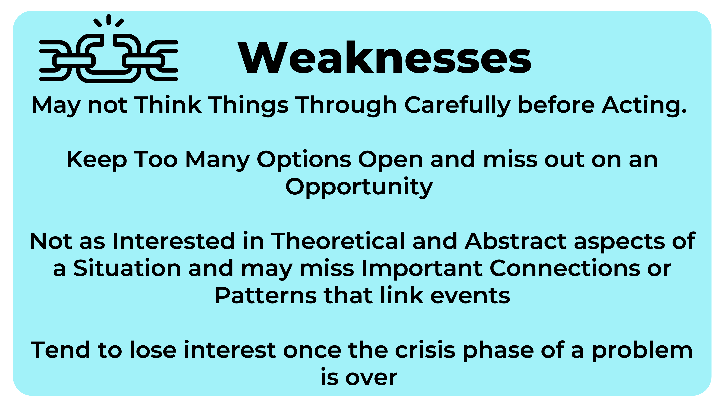
Strengths & Weaknesses of Improvisors

Slide 13
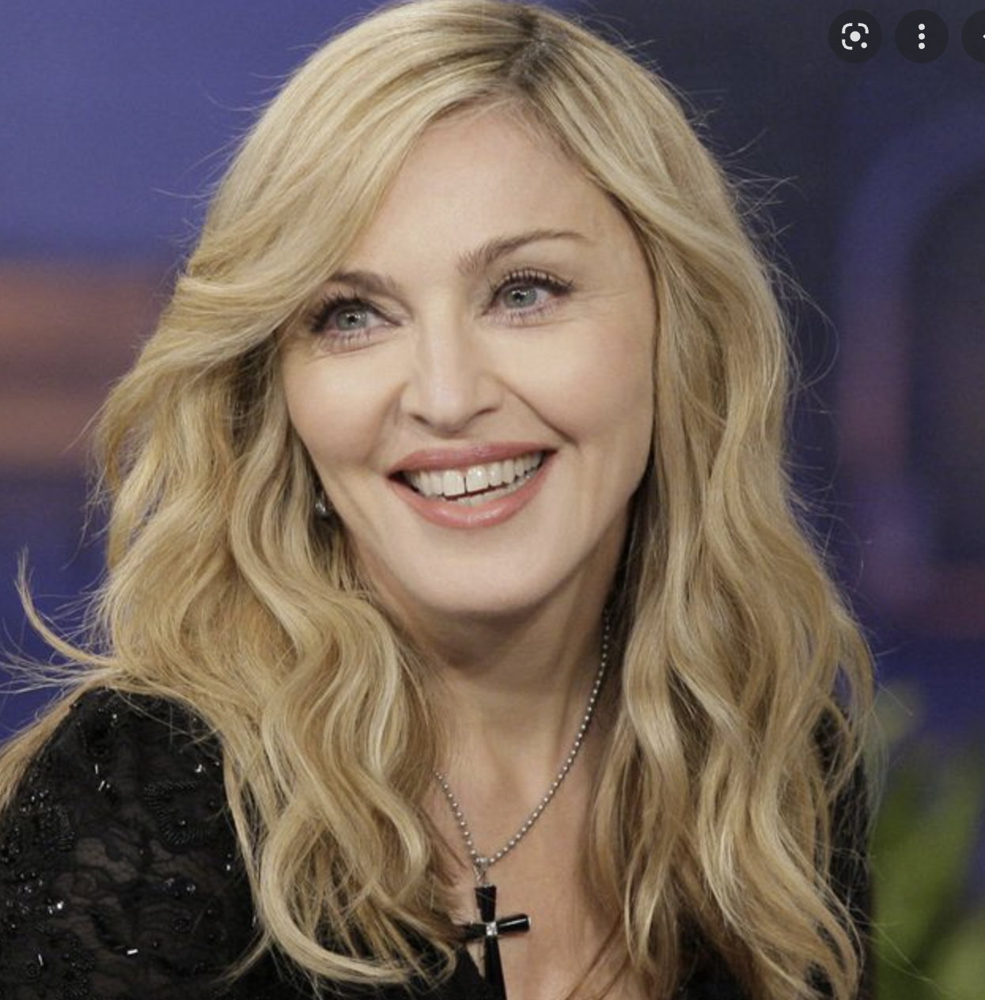

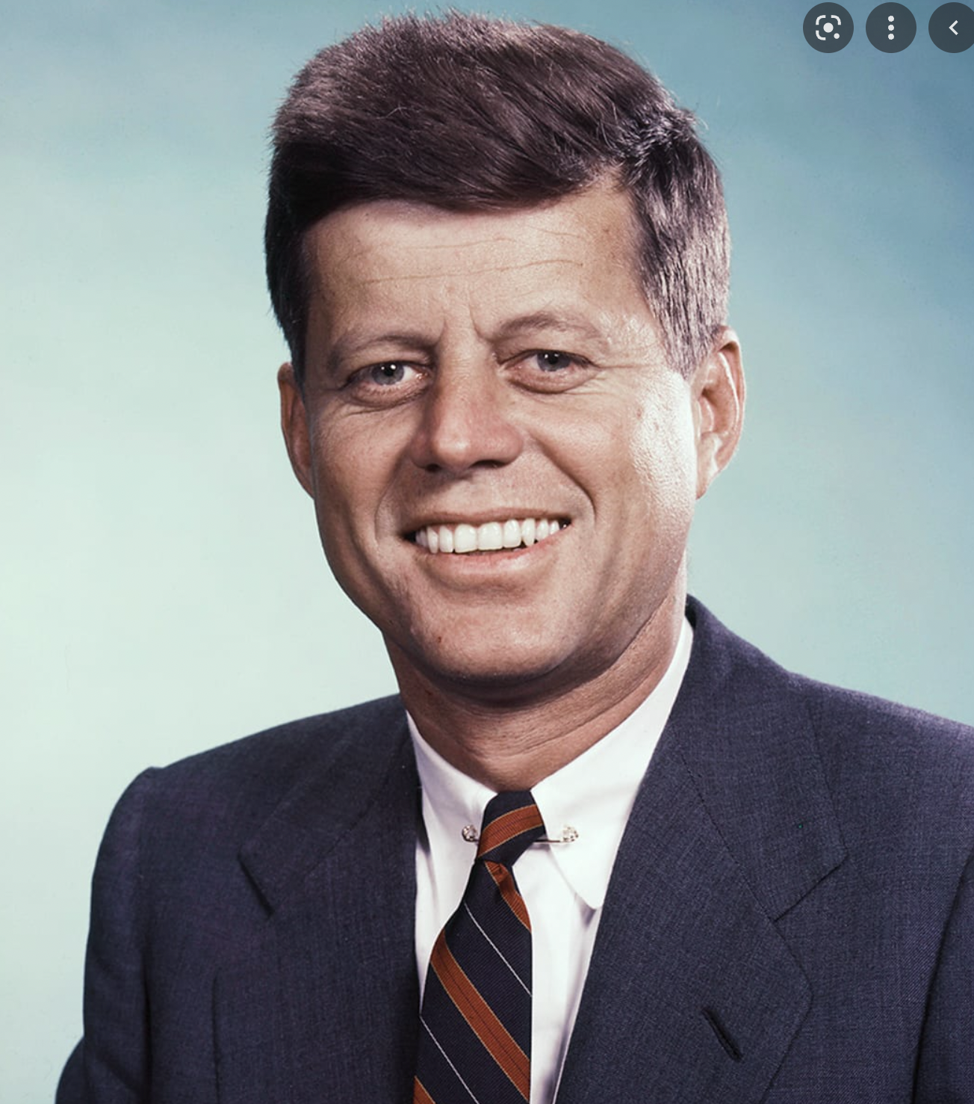
Career interests of Improvisers
Famous Improvisors:
Madonna, Lady Gaga and John F. Kennedy.
In education, Improvisors tend to be drawn to the artistic, craft, technical and athletic subjects and skills that they can use in their career.
They tend to seek work involving operations and equipment. They may be attracted towards
The Arts
Politics
Sports
Craftwork
Music & Dance
Film & Theatre

Slide 14

Theorists like Knowledge and feel best about themselves when Solving Problems.
They tend to be Independent, Strong-Willed, Pragmatic and Logical.
They are Naturally Curious, and usually can see many sides to an argument.
They are excellent at understanding complexities and designing solutions to real or hypothetical problems.

Slide 15
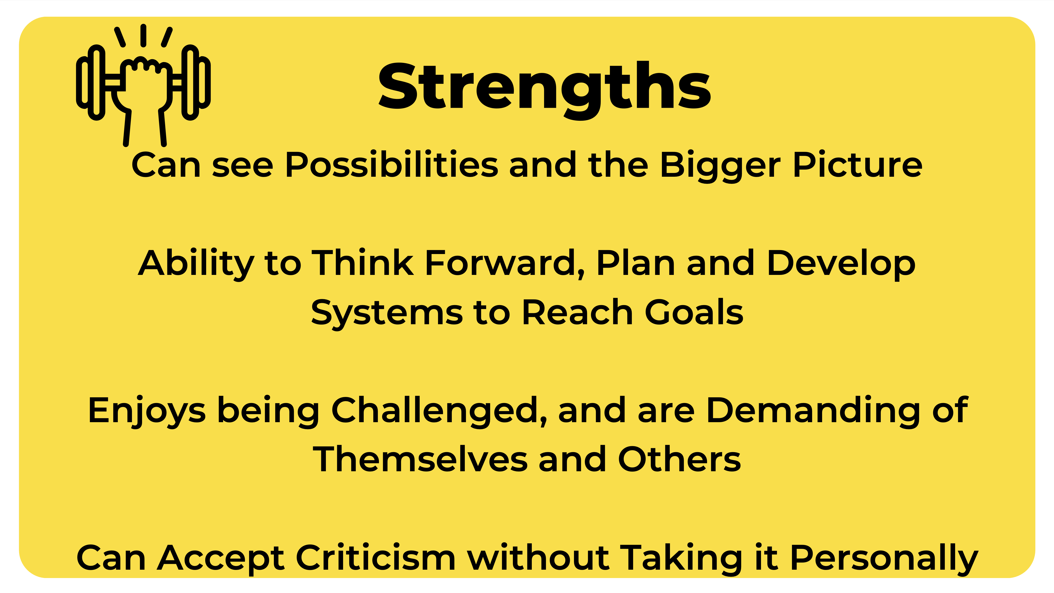
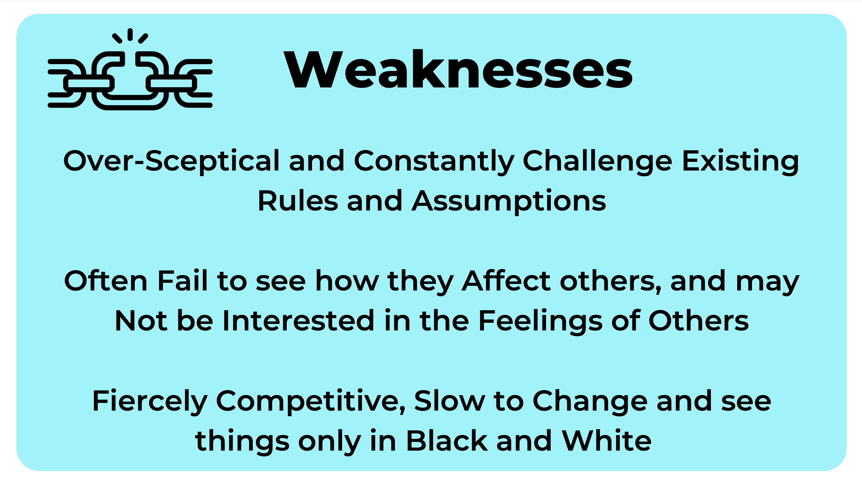
Strengths & Weaknesses of Theorists

Slide 16
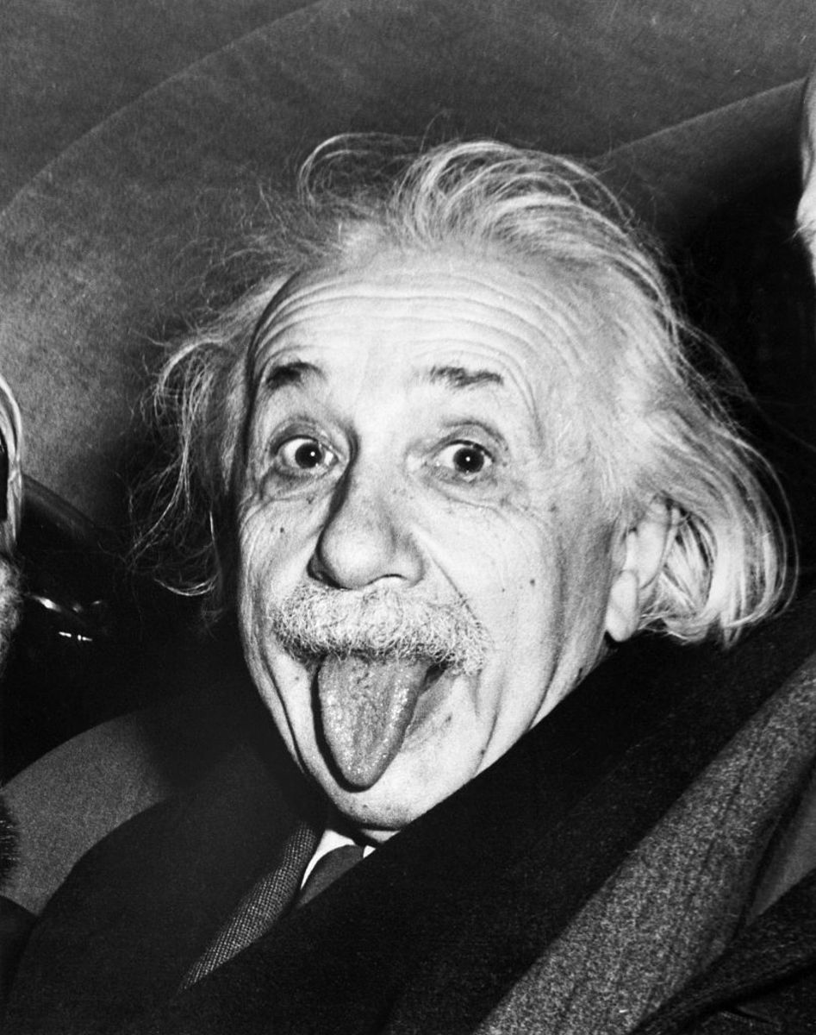
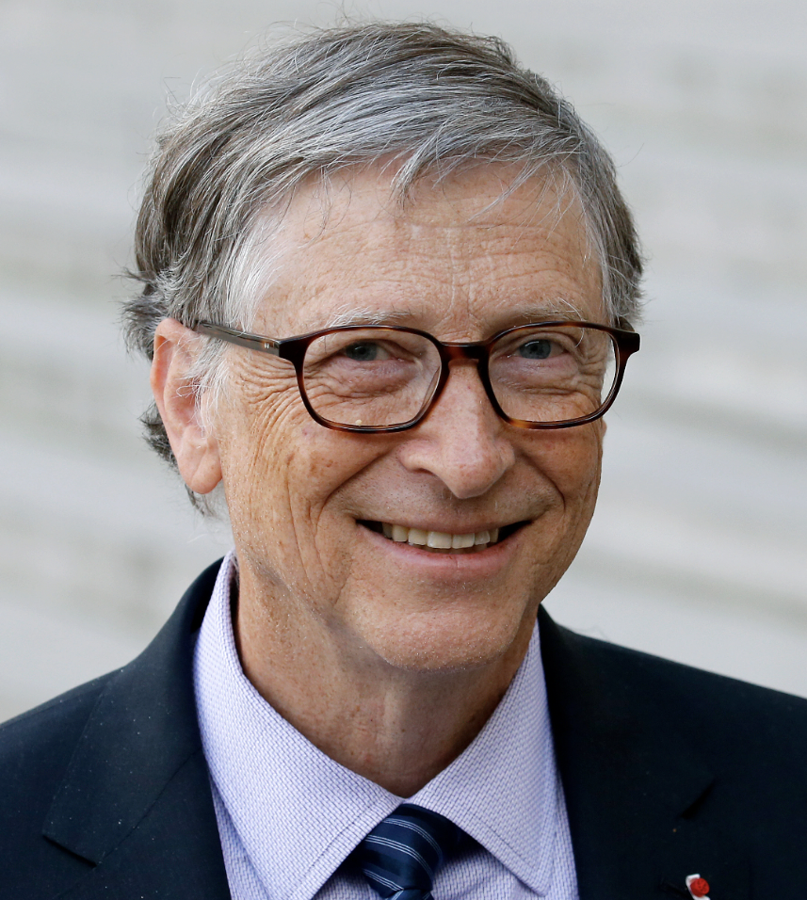
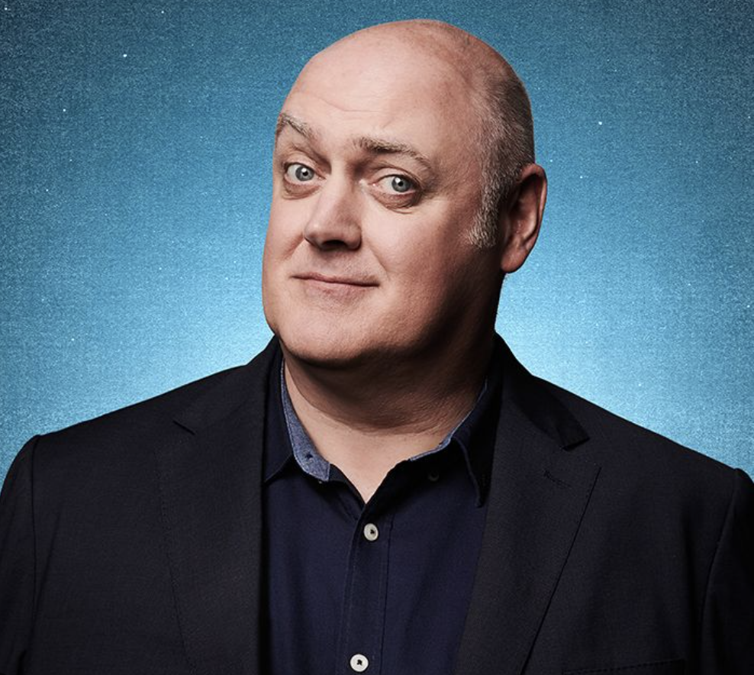
Career interests of Theorists
Famous Theorists:
Albert Einstein, Bill Gates and Dara Ó Briain.
In education, Theorists are often drawn to Science and Technology.
They usually seek careers involving Systems- whether Mechanical, Organic, Social or Organisational. They may be attracted towards the following sectors:
Engineering
Scientist
Psychology
Economics
Medicine
Law

Slide 17
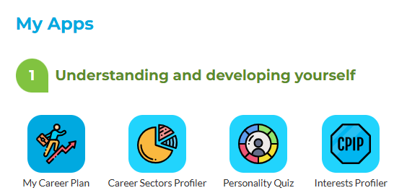
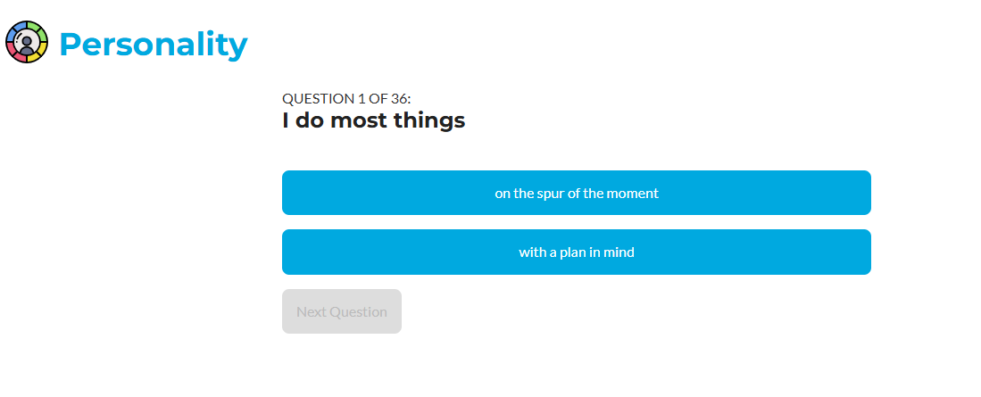
Step 1: Click on the Personality Quiz app
Step 2: Go through the Quiz by clicking on the answer that describes you best

Slide 18
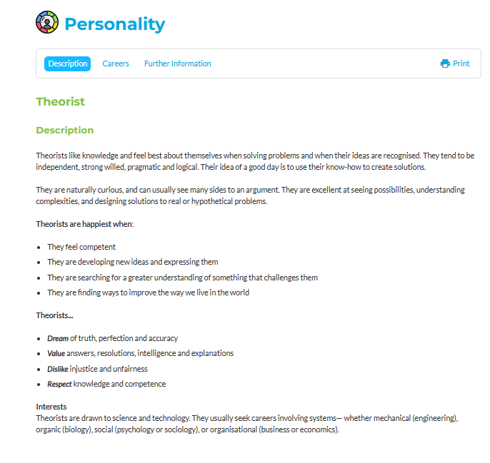
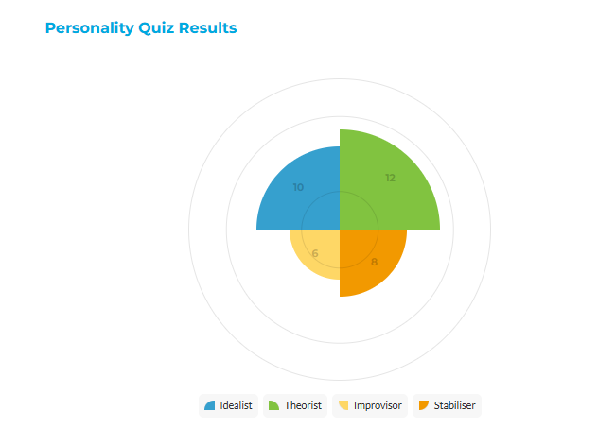
At the end of the on-line questionnaire you will find out your Top Personality Type is. You will see a graph and can print or save a PDF report.

Slide 19
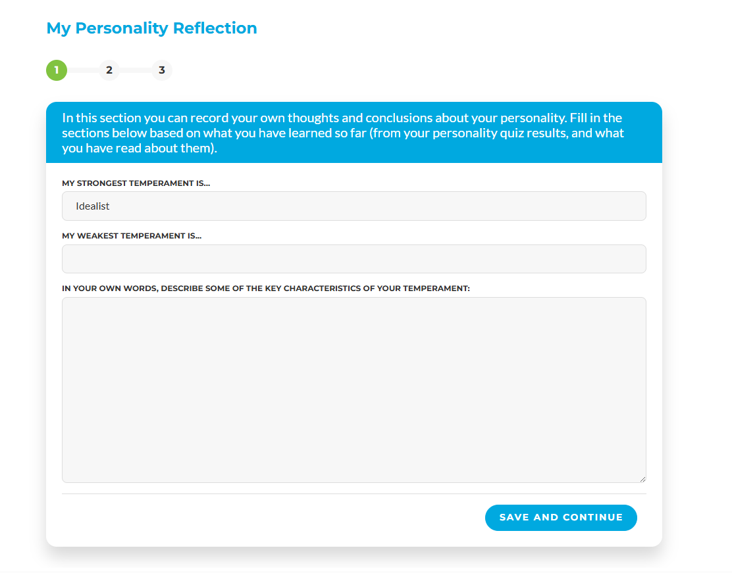

Exercise: Personality Quiz Reflection
It is important to include your thoughts and learning on your results and how these match to career areas:

Slide 20
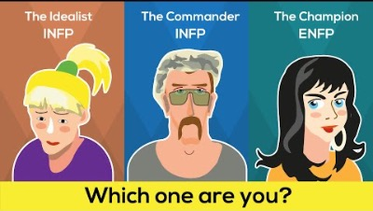
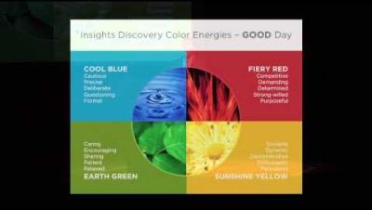
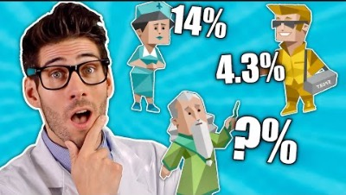
11-minute video. The concept of personality
15-minute video. Personality and the brain Ted Talk.
13-minute video. How rare is your personality type video?

Slide 21
Understand the definition of the term Personality
Have a deeper idea of other people, understand how they are alike, how they are different, and why they do what they do
Know about the Four Types: Improvisor, Stabiliser, Theorist and Idealist.
To understand personality types and how this can influence career choice
To reflect on your own top Personality Type; the strengths and weaknesses and careers that might suit you

